Slide 1
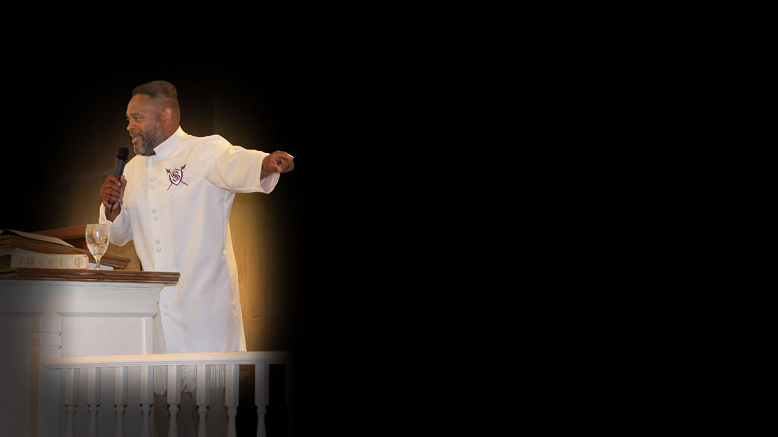

Prayer #1
Speaking Evil and Curses

Slide 2
My Messiah Jesus, I am laying down my life before you as a living sacrifice to you. I belong to you. I bring every single word that has been spoken against me in the spirit realm before you.

Slide 3
First I repent for ever speaking evil of others and I ask that you please forgive me. Jesus I ask that your blood now speak for me and be applied to me. I am truly sorry for all negative words I have spoken against others.

Slide 4
Every word the devil is using against me, that has been spoken by people or those in authority over my life. I ask that these words be cancelled annulled and I loose myself by the applied blood of Jesus

Slide 5
I ask that your blood cleanses me from all unrighteousness. I take full responsibility for my words and actions and ask that you please forgive me as I have forgiven others.

Slide 6
Jesus I ask that all sickness and all disease be removed from me. There is no sickness in heaven so I declare this here on earth for me and those who I release pray for.

Slide 7
I ask you to touch me with your healing power and heal me and remove all stain from me Father and my Judge in Jesus name.

Slide 8


