Slide 1
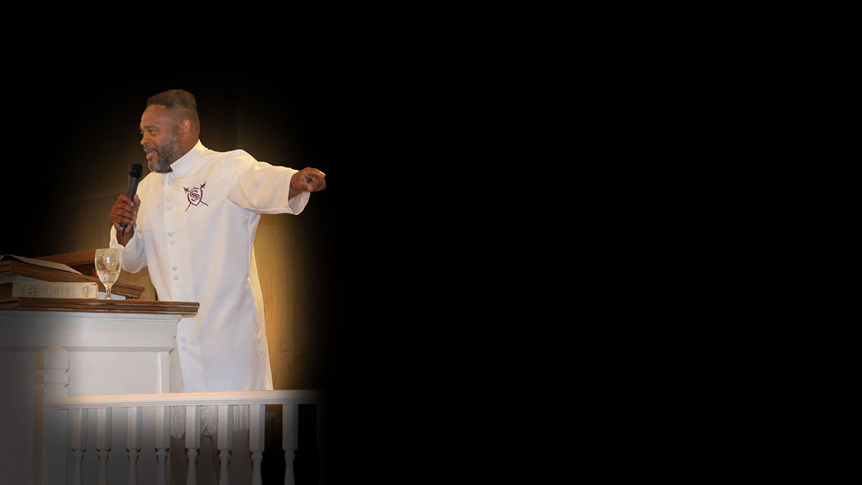

Prayer #2
Deliverance from Bloodline sins

Slide 2
A
Prayer

Slide 3
Abba Father, I come before You, the Judge of all things. I enter into your presents by the blood of Jesus my advocate and mediator.

Slide 4
I confess and repent and please ask you to help me to remember anything I may have missed in me or my family line.

Slide 5
I repent for rebellion, stubbornness, idolatry in my family’s bloodline also which I have committed against You.

Slide 6
I ask you to forgive me and I ask that the blood of Jesus to forgive me and cleanse me for every single time I have not walked right before you.

Slide 7
Forgive me when I have ignored your correction, please forgive me for disregarding Your desire and will for me because I was to rebellious and

Slide 8
Stubborn. Father and my Judge I repent for being lazy and being distracted from coming before you. I am sorry for every single time I disregarded

Slide 9
And ignored Your Holy Spirit leading me to present myself before you.
Jesus please remove every accusation against me.

Slide 10
I ask that any and all rebellion in my bloodline be revoked and remove by the blood of Jesus, I disagree with all rebellion against YHWH’s kingdom

Slide 11
my home, I ask Judge that the accuser my enemy my adversary the devil can no longer use my family’s past rebellion against me, nor my personal rebellion

Slide 12
Which the devil has used to accuse me, please revoke it by the blood of Jesus so that Healing which now belongs to me because I am the Father’s

Slide 13
Child. Father I ask for a full healing to manifest in my body now, I ask that my mind be restored to full obedience now.

Slide 14
Thank you for always being mindful of me through Your death, burial and resurrection and now seated on the Throne to make intercession for me.

Slide 15
Holy Spirit do the work of Yah’s kingdom in my heart and my families in Jesus name, thank my Abba, my Father and my righteous Judge.

Slide 16
For the ways of man are before the eyes of
and he pondereth all his goings. Thank you Father in Jesus name.

Slide 17


